Slide 1
Bayesian Optimization for Material Science Automation
A proof-of-concept project for industrial applications of Bayesian Optimization
Sarah Tucker
May 15, 2026
Notes:
Explain context of Presentation
Hello Everyone, my name is Sarah Tucker I’m a recent Masters graduate from the University of Connecticut. The presentation I am showing you today is based on a side project that a member of my research group and I did last fall on autonomous systems algorithms, we specifically looked at how Bayesian Optimization can be leveraged for guiding autonomous and high-throughput experiments in materials science.

Slide 2
Why use Bayesian Optimization?
Many engineering/science problems require extensive experimentation
Traditional testing can be slow and resource intensive.
The goal with Bayesian Optimization is to intelligently determine the next best test/experiment instead of randomly searching
Applications
Material Design (i.e. Batteries)
Drug development
Deep Learning
Autonomous Labs
Notes:
So before we get into what Bayesian optimization is a good starting point is answering the question Why Bayesian Optimization?, what makes it an appealing tool for scientists? Well as you are probably familiar with testing experimental hypothesis is often time consuming and expensive, so going through a trial-and-error phase of development is not always feasible. That is where Bayesian Optimization can be implemented, BO is a machine learning algorithm that can learn to intelligently pick the next best test or experiment. A good example of this is Battery design, there are hundreds if not thousands of material mixture combinations when it comes to developing a potentially good battery, but to manually test all combinations would be arduous. But by applying a BO algorithm you can shorten the lists of potential candidates to manually test, automatically weeding out the “bad” or underperforming mixtures.
Bring in the project introduction → the problem
Material science people like battery but how find that when you have BO

Slide 3
What is Bayesian Optimization
Initial Data
Model learns from previous experiments
Balances between
Exploration: trying new regions
Exploitation: focusing on promising regions
Observe Data
Update Model
Train Predictive Model
Sample next point
Estimate next best point
Notes:
Real quick I’ll go over a high-level overview of the BO algorithm before getting into our specific dataset and implementation. BO is an iterative algorithm that combines statistical modeling and decision-making strategies to optimize complex, costly functions. In general, the process goes something like this (point to flow chart) You start with a labeled dataset which is randomly samples by the BO algorithm which are made the initial points. (Selecting random point ensures you have a diverse and comprehensive coverage of the input data) The you build what is called a Surrogate model, aka the predictive model, this is usually a pre-built package that you can implement in your code in this case we used a Gaussian Process. The next sampling point is then chosen through the acquisition function, this portion sequence tries to pick points that are both unexplored or unseen and the most promising, think in the case of batteries the most conductive. The algorithm then tests this new point and determines if it should be kept or not, if it determined to be a good point then it is added to the observed data pool. These steps then iterate and with each iterate the model becomes increasingly more accurate, and the process continues until a predefined stopping criteria is met (Reaching the max number of function evals or achieving a threshold where improvements become minimal).
Tie back to physical thing i.e batteries

Slide 4
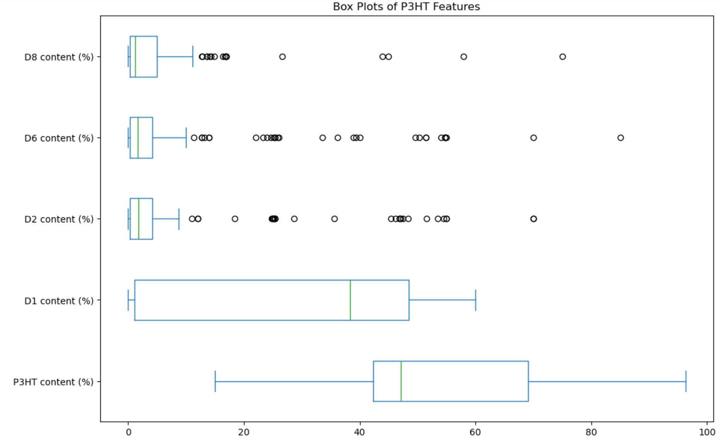
P3HT Dataset
Material science dataset
5 material composition variables (D1, D2, D6, D8, and P3HT)
Goal was maximizing electrical conductivity
Notes:
Ok now that I’ve gone over some context for the project lets get into what we did. So the dataset we worked with is list of varying composite polymer blends and carbon nanotubes material measurements, with the goal of choosing the best measurements for maximizing conductivity.
More time and explain images (maybe combine)

Slide 5
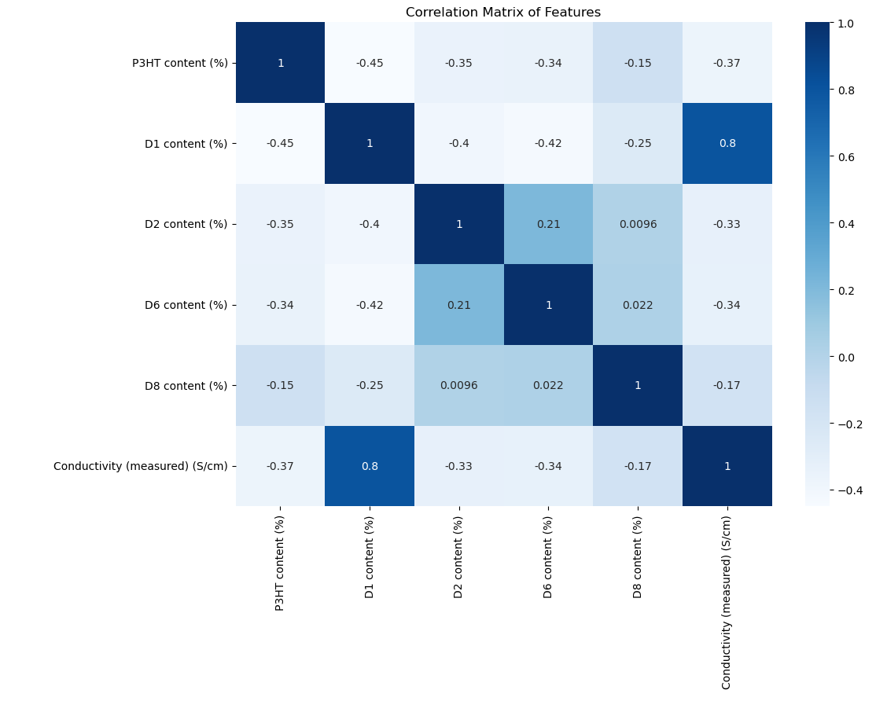
Data & Feature Analysis
D1 has strong correlation with conductivity → focus on using this as a base-line (add correlation matrix)
Part of BO is determining which input variables actually influence performance
The model learned which variables mattered most
Notes:
While analyzing the dataset my partner and I noticed a strong correlation between the D1 composition measurement and electrical conductivity, so we were able to test the rigorously test the model by using the D1 input as a baseline. That is to say, if our model does well predicting the best points on the D1 data then it would be safe to say the it would do well on the other compositions.

Slide 6
Implementation
Data preprocessing and normalization
Iterative model-training workflow
Automated experiment selection
Performance benchmarking against random sampling
Gif from Sam Wilsons Par Bayesian Optimization GitHub package
Notes:
The code we built is an optimization pipeline that repeatedly evaluates the model, selects the next candidate measurement, updates the training data, and compared performance against random sampling. The visual I have here is a good representation of the process our code goes through, basically we’re trying to get the model to predict the black line and after every iteration of training it gets closer and closer to the true function.
(explain black line better) any model you want you like

Slide 7
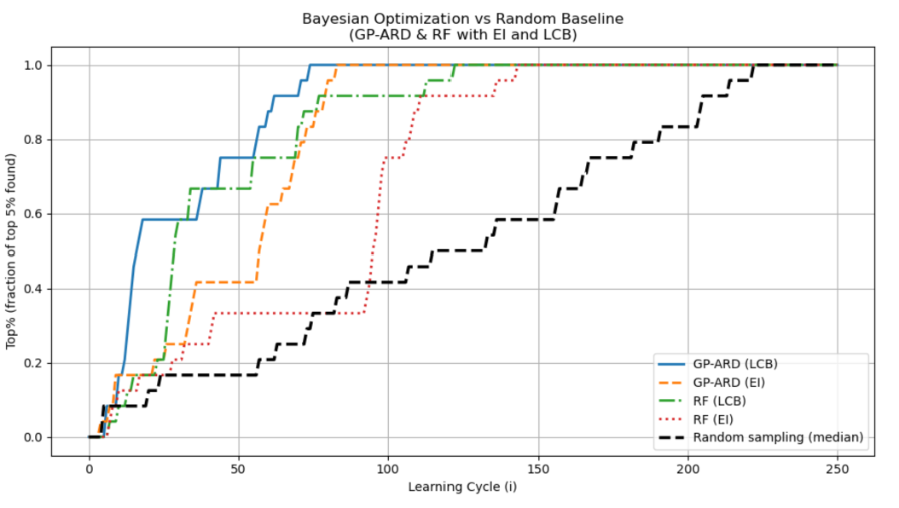
Results
BO found high performing candidates significantly faster than random sampling
The algorithm learned where the high-performing regions were and concentrated testing there, dramatically reducing the number of experiments needed
Notes:
Our results were to be expected, the BO model was able to find the most conductive measurements much faster than random sampling and it could learn what regions of the data were most relevant and ignored measurements that were underperforming.

Slide 8
Main Takeaways
BO found high-performing candidates much faster
Can reduce unnecessary or underperforming experiments
System successfully learned high-performing regions automictically
BO can be a powerful tool when faced with a scenario where the solution is expensive to solve
BO is becoming mainstream in many different fields – deep learning, materials science, robotics, and scientific simulations
Notes:
Add in my role in the project
Skills I learned I bring to them
Fiber optics test tie In
Save time save money emphasis

Slide 9
Thank you!

Slide 10
Backup Slides

Slide 11
Background
BO proposed around 1970
Started as mathematical theory and transitioned to computer science in the 1990’s
Becoming a mainstream tool in material science, drug development, medical experiments, and deep learning
Gif from Sam Wilsons Par Bayesian Optimization GitHub package

Slide 12
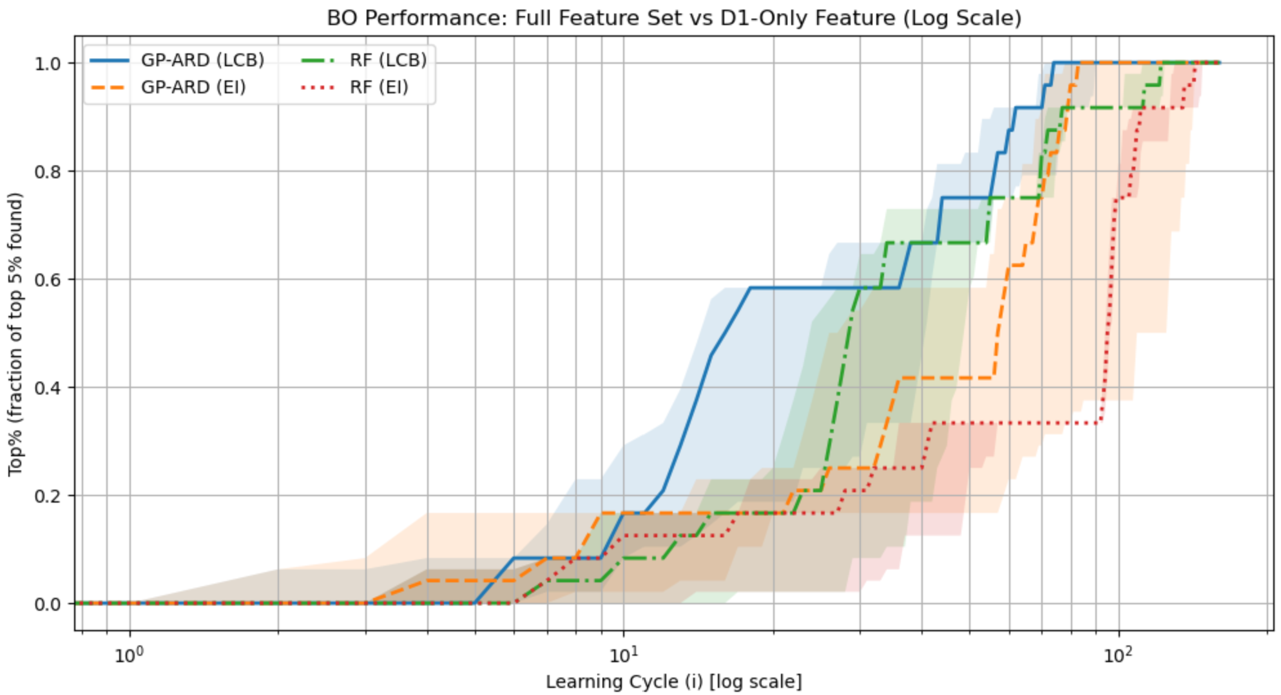
Background - Acquisition Functions
Acquisition Functions: method of determining the next best step
LCB = Lower Confidence Bound
EI = Expected Improvement
Notes:
EI calculates the expected value of the difference between a potential new observation and the current best, ignoring any points where the observation is worse
LCB is looking for a global minima, it searches for points where the results is likelky to be very low by evaluating two factors: 1. it looks for points with a low predicted mean and 2. it looks for points with high uncertainty. The lower the LCB the more the model is encouraged to sample unexplored regions to reduce its ignorance.

Slide 13
Data – P3HT/CNT
Dataset containing 178 samples of a composite blend of polymer + carbon nanotubes
5 independent input features
P3HT content
4 different measurements of CNT mass fraction/ratio: total mass that is made up of Carbon nanotubes
Labeled as D1, D2, D6, and D8
Target Variable: electrical conductivity

Slide 14
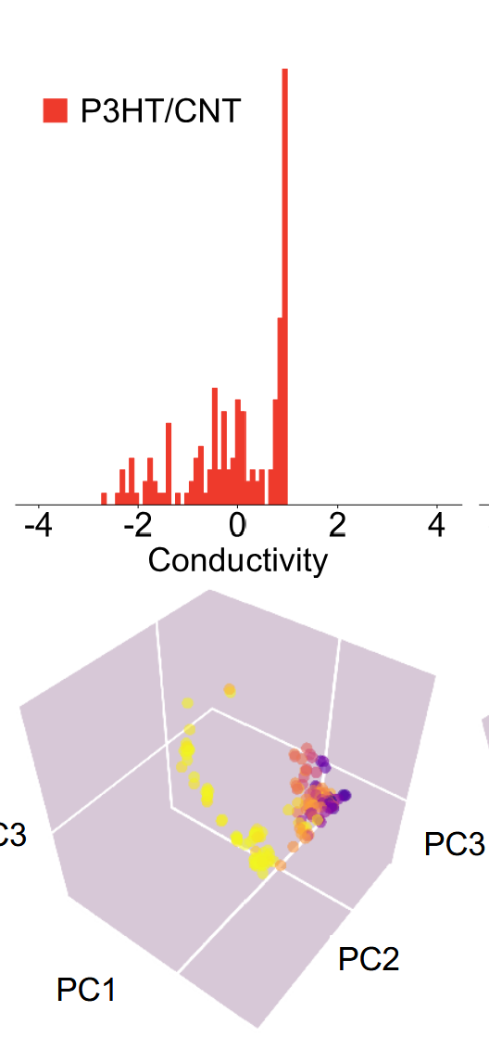

Data – Distribution of Variables and Labels
Features:
Distributed continuously across 5D space
After a PCA reduction to 3D, the design space shows moderate complexity – neither uniform nor clustered strongly
Each dimension was normalized (centered and scaled)
Labels:
Normalized (approx. zero-mean, unit variance)
Roughly bell-shaped but slightly skewed distribution (Figure 1a) – reflects experimental noise and a spread in conductivity across different compositions
Values span both higher and lower performing regions (PCA plots show smooth gradients)
Notes:
PCA – principle component analysis, -- squishes it down into more important dimensions P3HT content and D1

Slide 15
Data – Distribution of Features
• D8, D6, and D2 contents are concentrated – this matches with their low correlation with the objective value
• D1 and P3HT contents sampled over a much wider region – seems to reflect the BO attempting to find the optimal value in design space

Slide 16
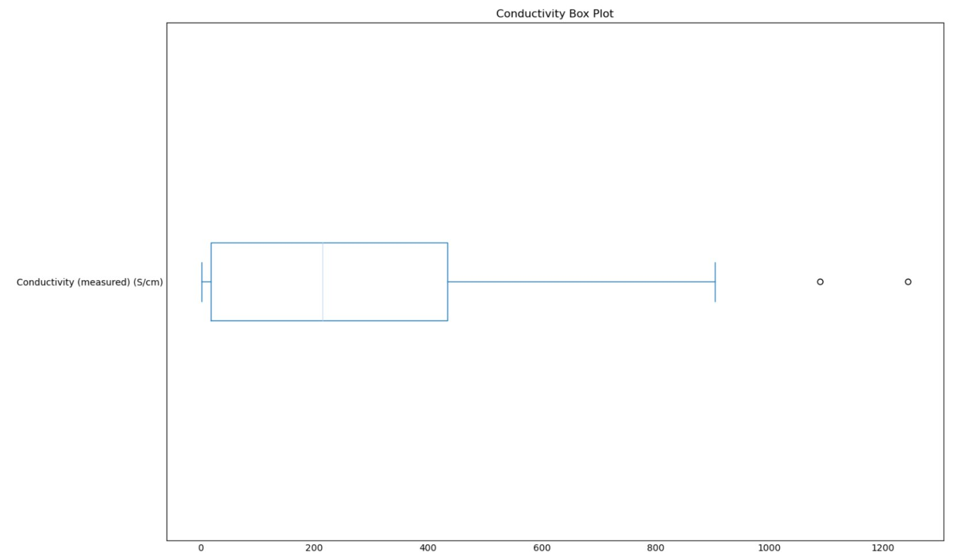
Data - Objective Value Distribution
• Original experimental goal was to maximize conductivity
• Wide range of objective values
BO was able to reach quite high conductivity
Many tests resulting in low conductivity

Slide 17
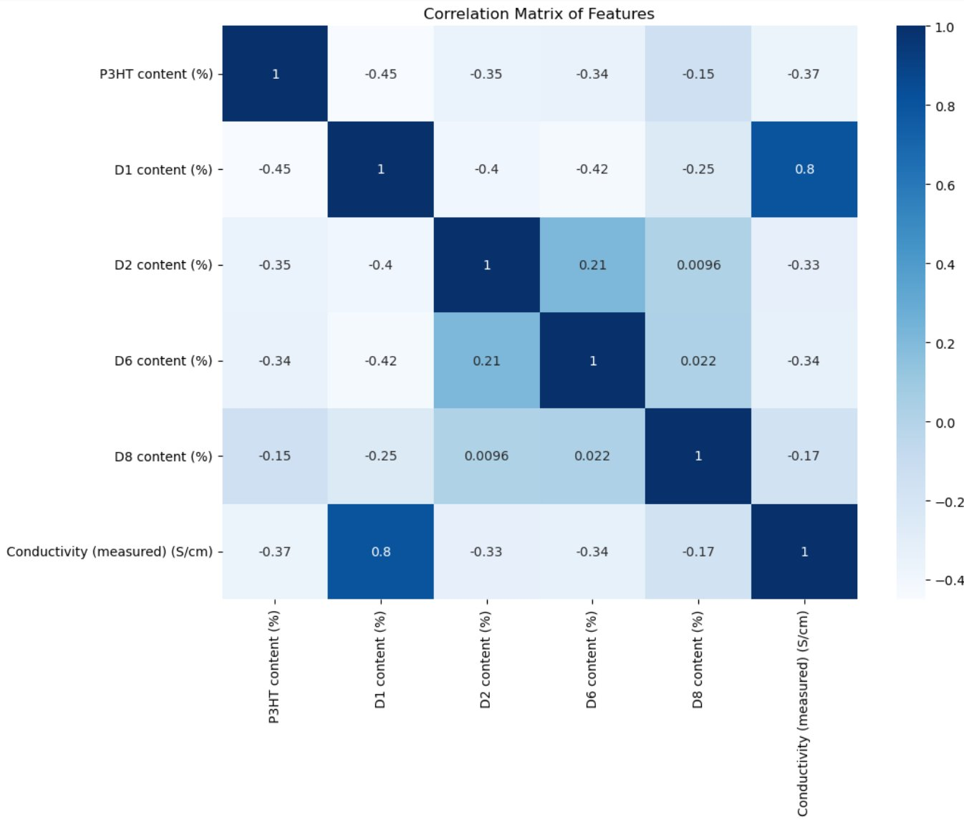
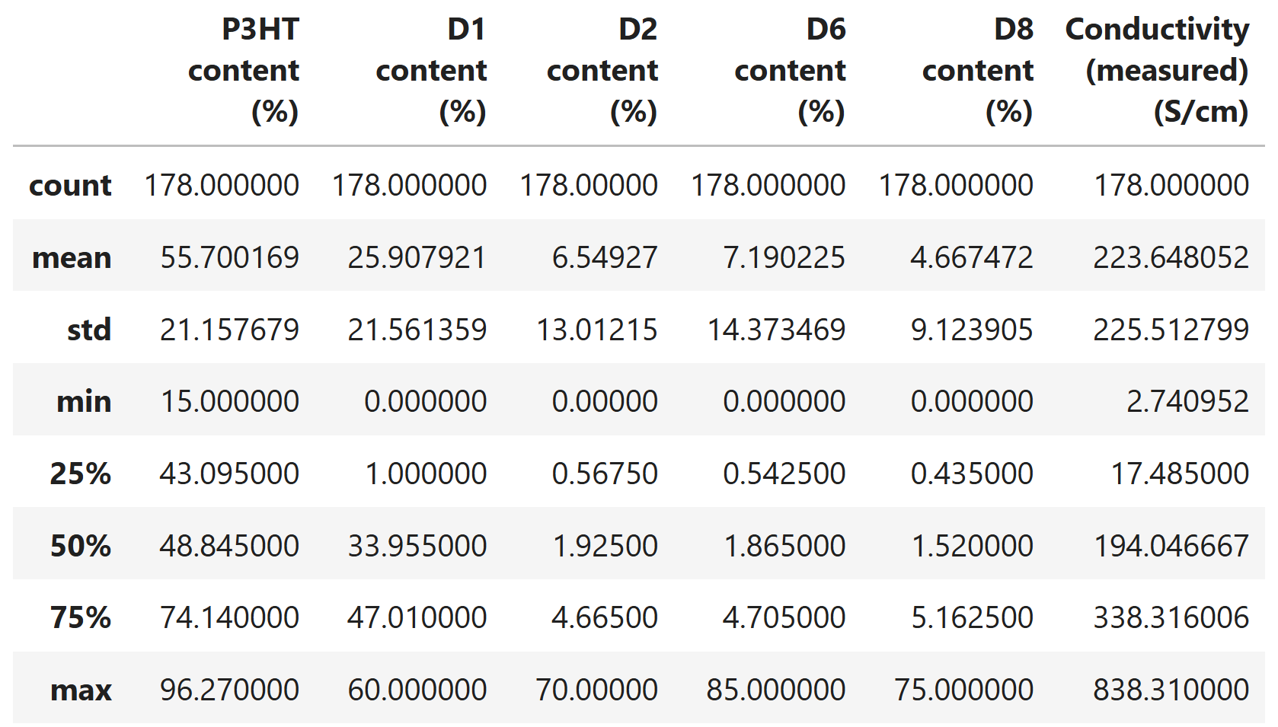
Data – Summary & Correlation Matrix

Slide 18
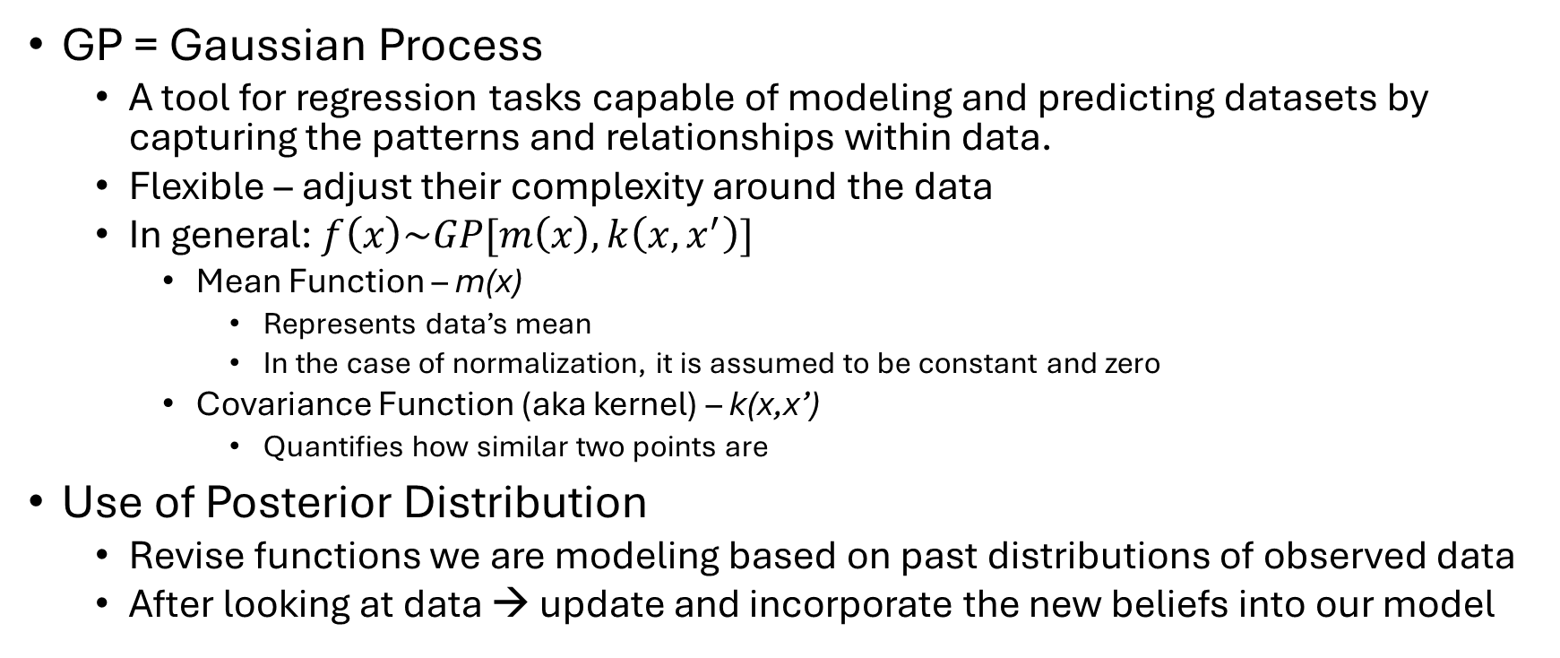
Algorithm – GP with ARD
GP = Gaussian Process
A tool for regression tasks capable of modeling and predicting datasets by capturing the patterns and relationships within data.
Flexible – adjust their complexity around the data
In general: $f\left(x\right)\sim GP[m\left(x\right), k\left(x, x^{′}\right)]$
Mean Function – m(x)
Represents data’s mean
In the case of normalization, it is assumed to be constant and zero
Covariance Function (aka kernel) – k(x,x’)
Quantifies how similar two points are
Use of Posterior Distribution
Revise functions we are modeling based on past distributions of observed data
After looking at data → update and incorporate the new beliefs into our model
Notes:
In regression, GPs predict continuous outcomes. Given training data (X,y), the GP provides a predictive distribution for new inputs X∗:
$$p\left(y_{∗} , ∣ , X_{∗}Xy\right)$$
GPs are especially good for problems with patterns, i.e. weather, the stock market,

Slide 19
Algorithm – GP with ARD
ARD = Automatic Relevance Determination
Implemented using anisotropic kernels
Add to the lengthscales of the features to help measure relative importance
Without ARD, GP might miss contributions from the P3HT content, D2, D6, and D8 inputs due to D1 having more correlation
Allows GP to “catch up” to the performance of RF
Notes:
In regression, GPs predict continuous outcomes. Given training data (X,y), the GP provides a predictive distribution for new inputs X∗:
$$p\left(y_{∗} , ∣ , X_{∗}Xy\right)$$
GPs are especially good for problems with patterns, i.e. weather, the stock market,

Slide 20
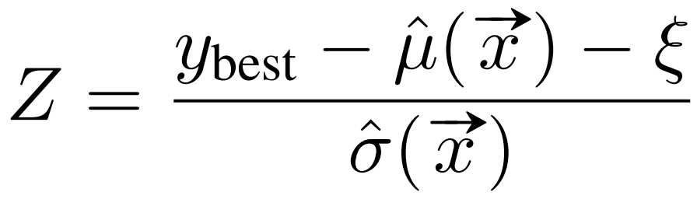
Algorithm - Expected Improvement as the Acquisition Function
Improvement: I(x_{new}) = max( f(x_{optimal}) - f(x_{new}) , 0 )
Expected Improvement(EI) quantifies by how much a new measurement improves the objective function relative to its current optimum
ξ is jitter to allow for exploration, Φ(Z) and ϕ(Z) are the cumulative density function(CDF) and probability density function(PDF) of a normal distribution respectively

Slide 21
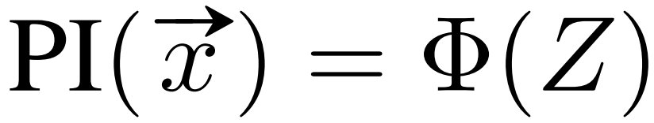
Algorithm - Expected Improvement as the Acquisition Function
Probability of Improvement(PI) is a part of Expected Improvement through the CDF
EI takes both the CDF and PDF into account with guidance from the surrogate model distribution
Fairly dramatic covariance matrix elements in P3HT dataset – GP ARD is sensible way to formulate our surrogate model distribution
Dependence of inputs on EI should match the lengthscales from GP ARD

Slide 22
Algorithm - Benchmarking Performance
Baseline: D1 content feature
Has strong correlation with conductivity
Compare results to other input data, if model does well with D1 then it probably did well with other inputs

Slide 23
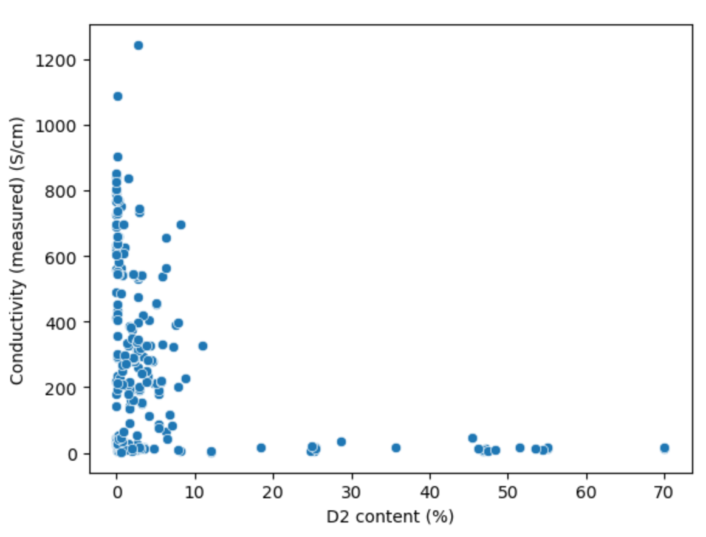
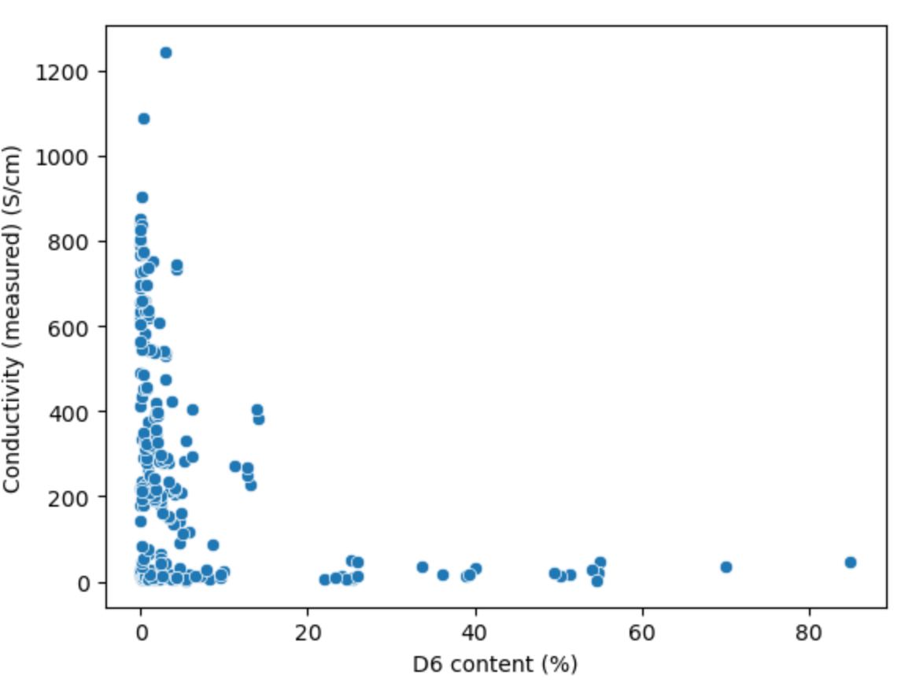
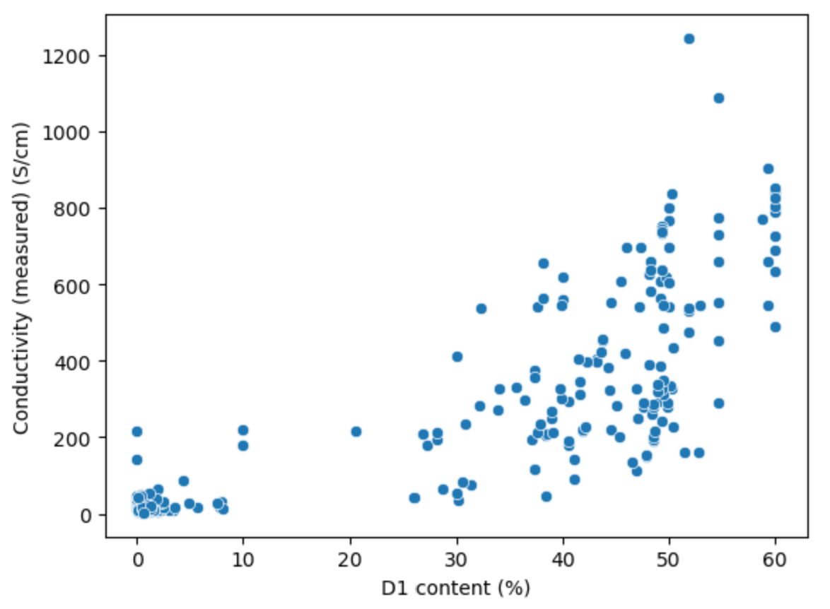
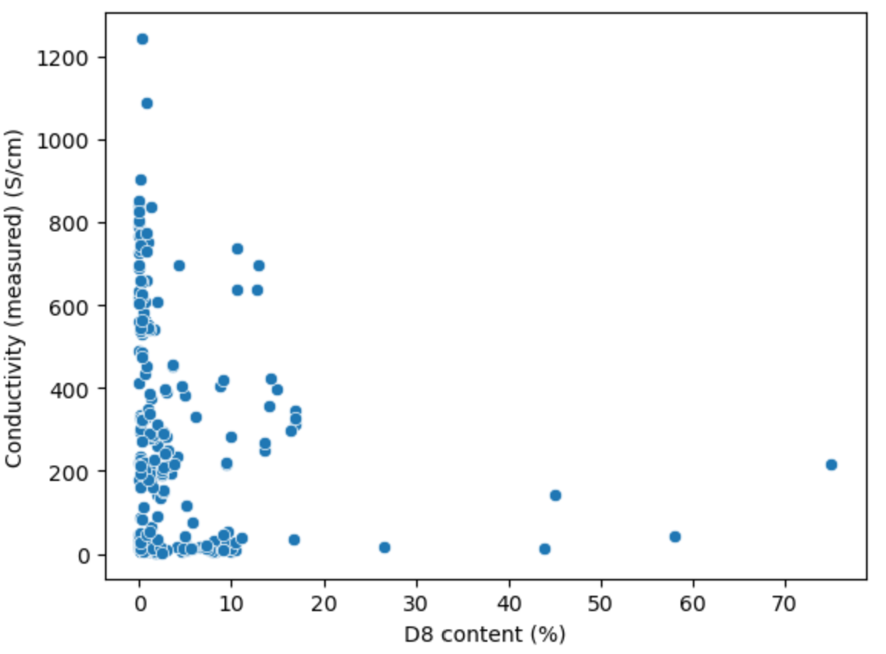
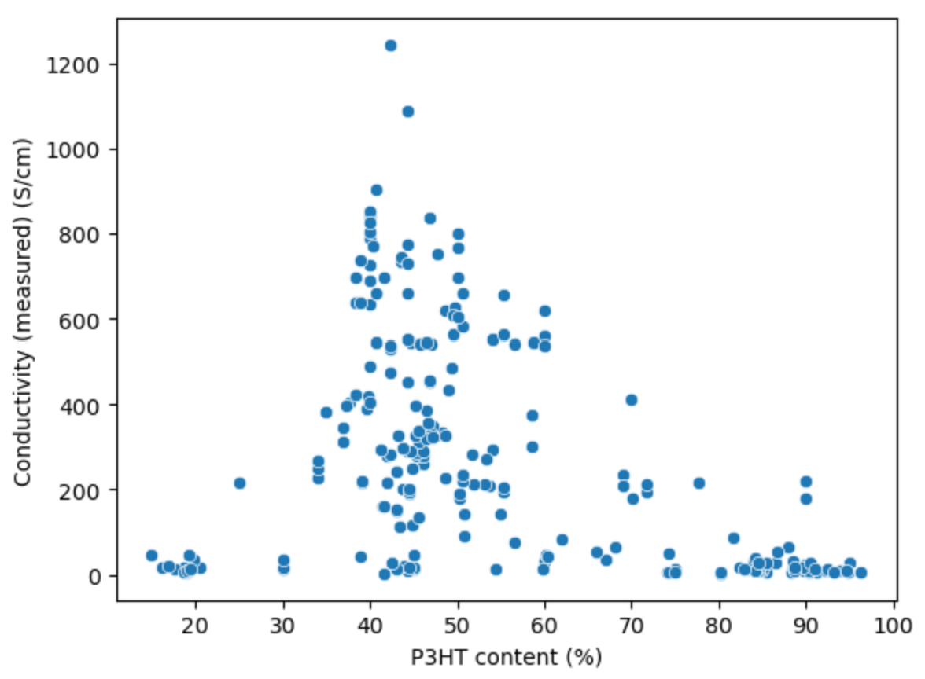
Algorithm - Correlations between Data
VS

Slide 24
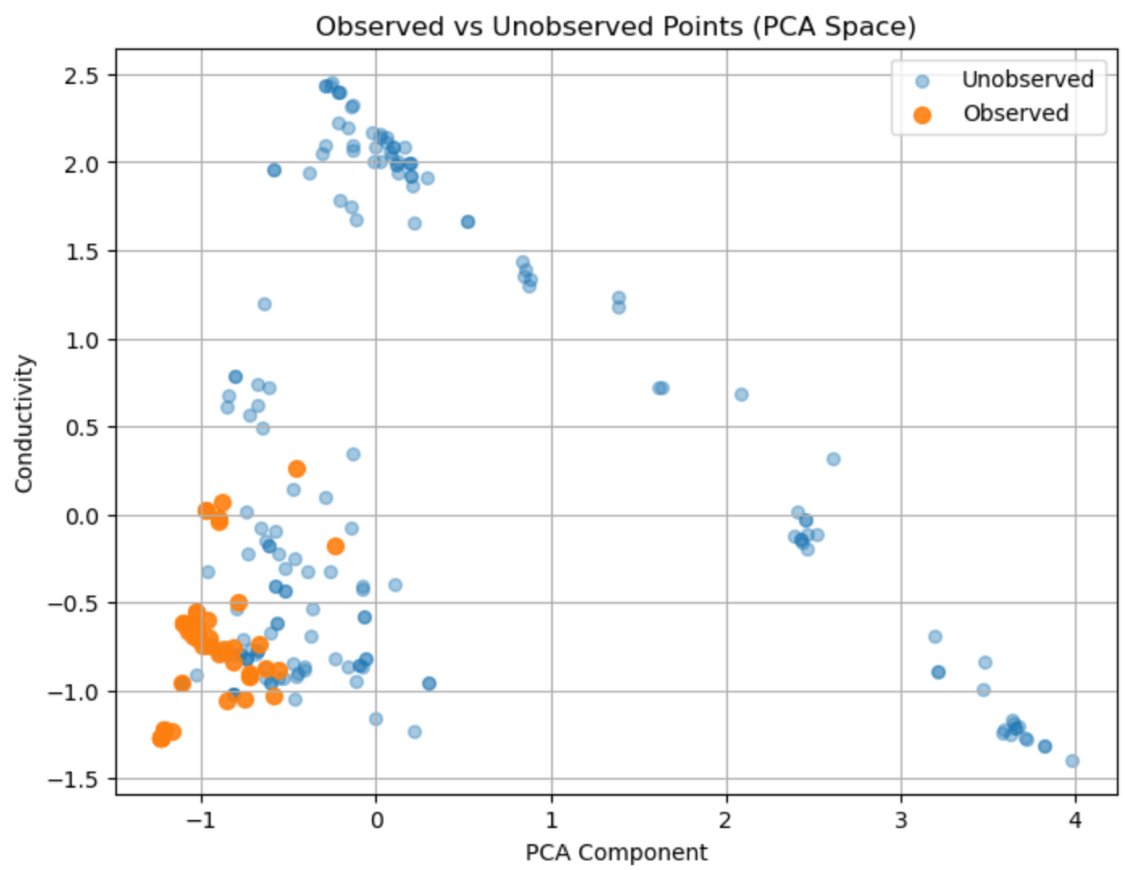
Results – Data Observation

Slide 25
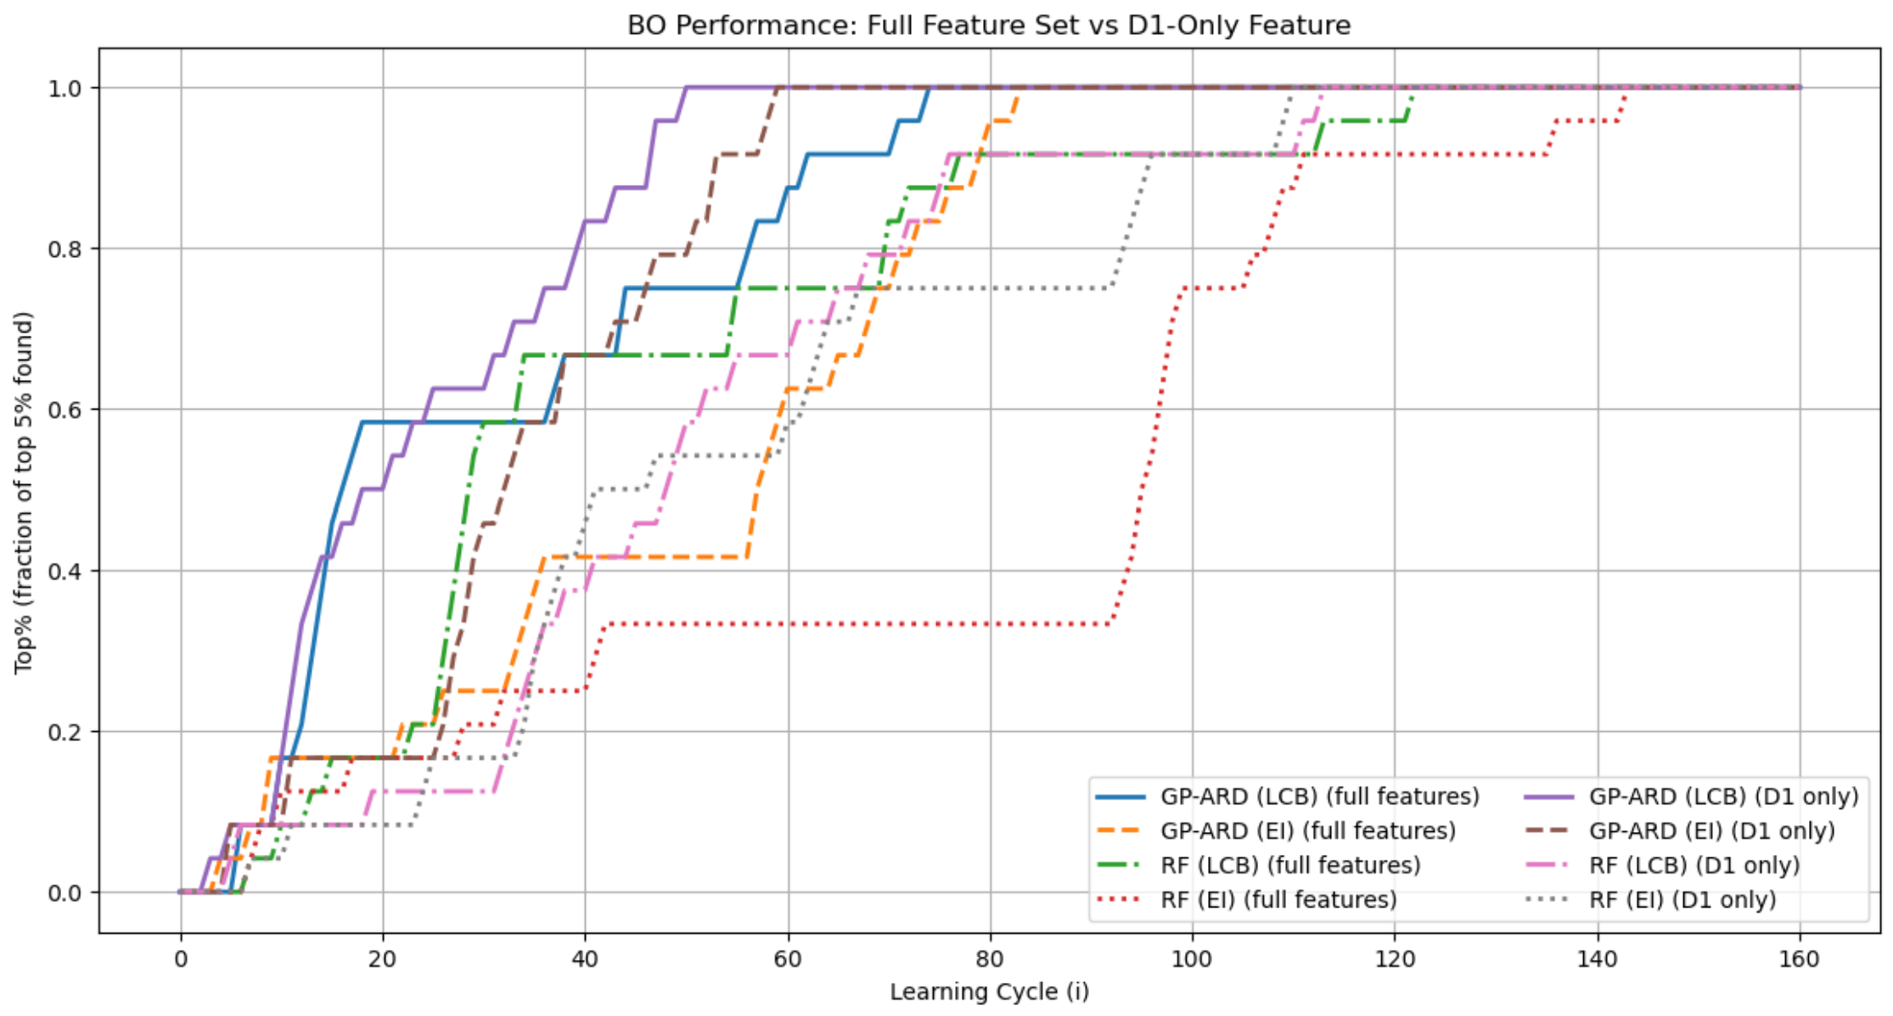
Results – Baseline Comparison

Slide 26
Feedback
Stuff about me, my role in the project
More experience spearheaded project im cool
Brag
Challenge good

